Slide 1
Python Packages

Slide 2
Outline
How to import packages
Numpy
Pandas
Matplotlib

Slide 3
Use import to load a library module into a program’s memory.
Then refer to things from the module as module_name.thing_name.
Python uses . to mean “part of”.
Use from ... import ... to load only specific items from a library module.
Then refer to them directly without library name as prefix.
Use import ... as ... to give a library a short alias while importing it.
Then refer to items in the library using that shortened name.

Slide 4
import math print('pi is', math.pi) print('cos(pi) is', math.cos(math.pi))
from math import cos, pi
print('cos(pi) is', cos(pi))
import math as m
print('cos(pi) is', m.cos(m.pi))

Slide 5
Numpy
import numpy as np
https://numpy.org/doc/stable/reference/index.html

Slide 6
Array?
An array is a central data structure of the NumPy library.
Is a grid of values and…
Contains information about the raw data
how to locate an element,
how to interpret an element.

Slide 7
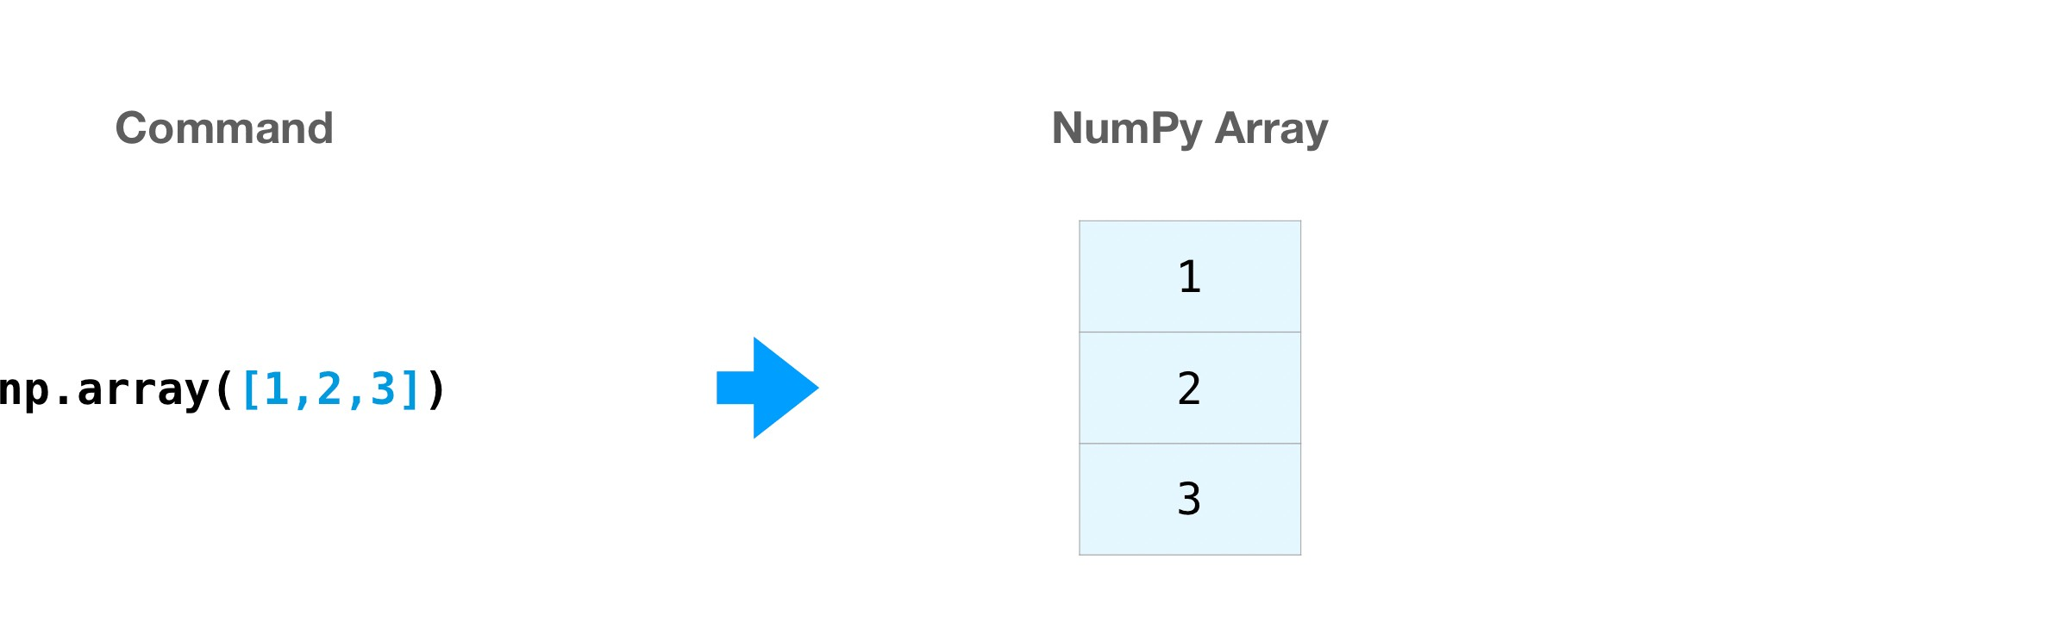
Numpy
np.array([Arrays Arrays Arrays])
a = np.array([1, 2, 3, 4, 5, 6])
a = np.array([[1, 2, 3, 4], [5, 6, 7, 8], [9, 10, 11, 12]], dtype = object)

Slide 8
np.arange()
start = 1
stop = 11
step = 1
x = np.arange(start, stop, step)
print(x)
>>> [ 1 2 3 4 5 6 7 8 9 10]

Slide 9
np. linspace()
start = 0
stop = 100
n_elements = 101
x = np.linspace(start, stop, n_elements)
print(x)

Slide 10
np. linspace() vs np.arange()
Can define stepzie with arange
Can define number of steps with linspace

Slide 11
np.where()
x_5 = np.where(x%5 == 0)
print(x_5)
print(x[x_5])

Slide 12
np. savetxt() | np.loadtxt()
start = 0
stop = 100
n_elem = 501
x = np.linspace(start, stop, n_elem) y = (.1*x)**2 - (5*x) + 3
np.savetxt('myfile.txt', np.transpose([x,y])) data = np.loadtxt('myfile.txt')
print(data)

Slide 13
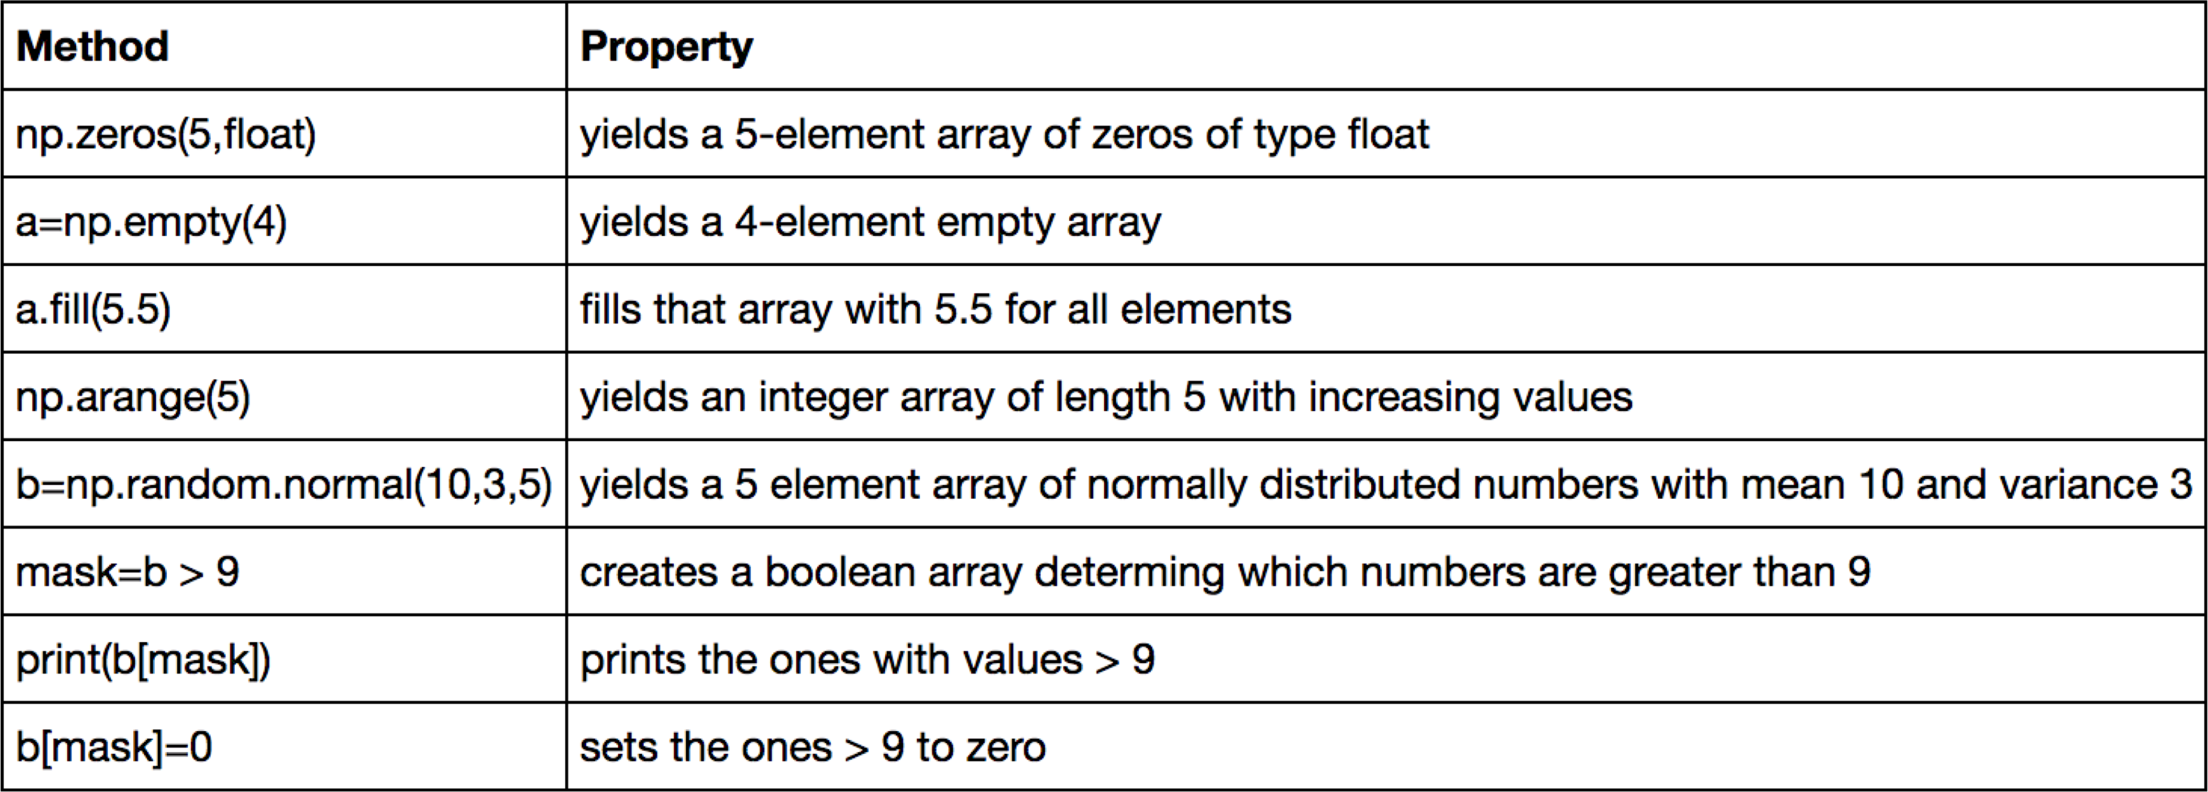
Some numpy methods

Slide 14
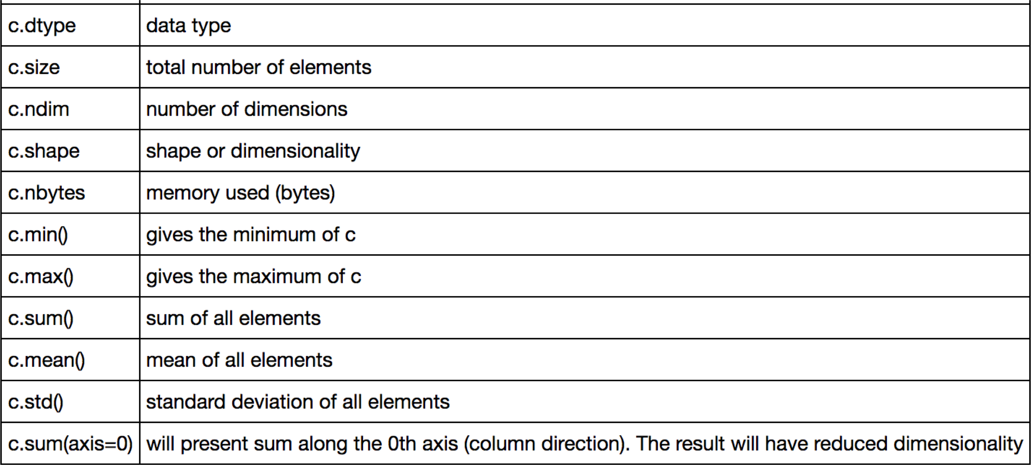
Some numpy methods
c=np.random.normal(10,3,(2,4))
Creates a 2 x 4 array with normally distributed numbers with mean 10 and variance 3.

Slide 15
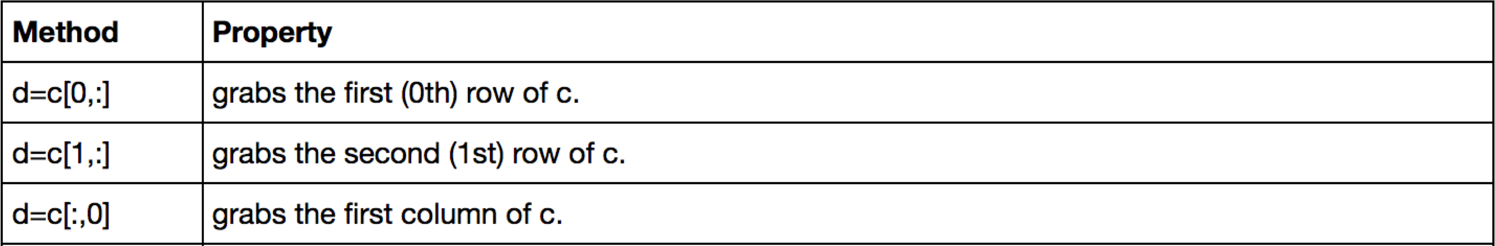
Indexing revisited

Slide 16


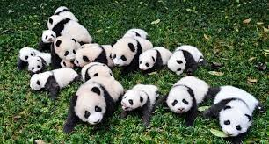
Pandas
import pandas as pd
https://pandas.pydata.org/docs/

Slide 17

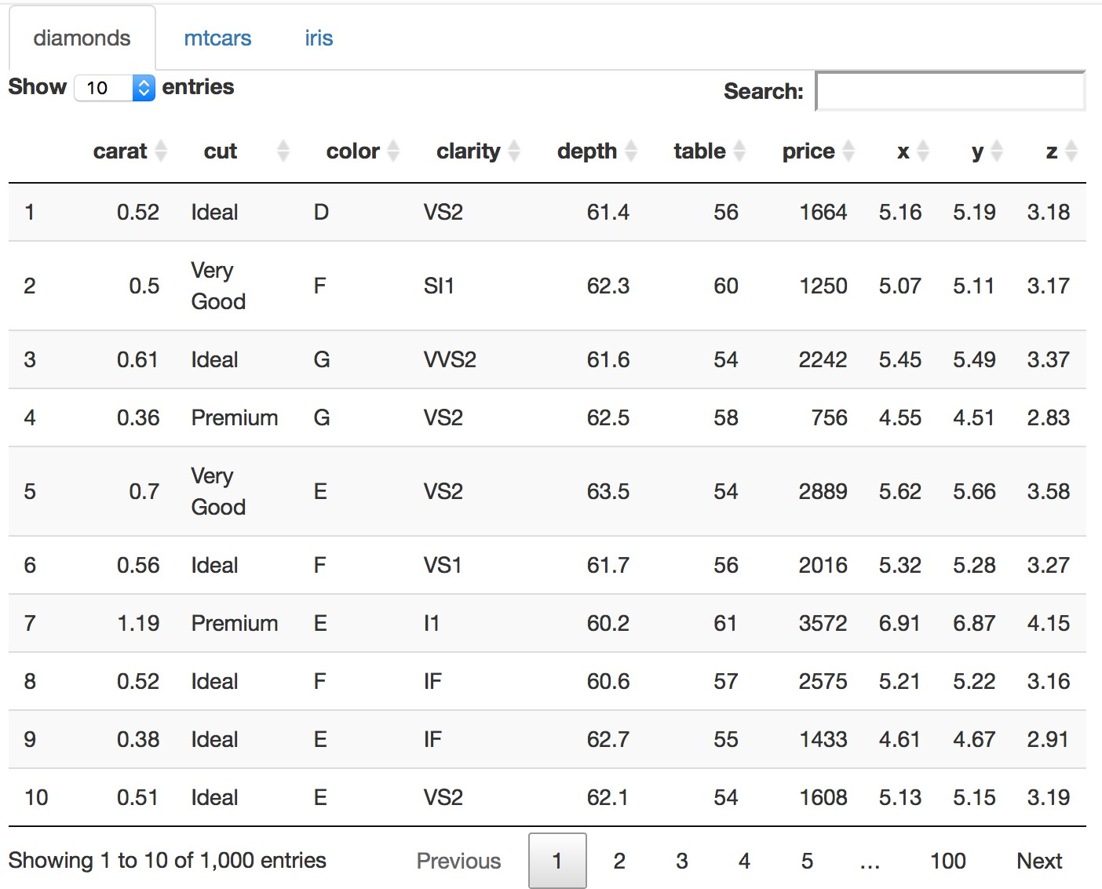
Pandas
Great for reading data
Data manipulation with integrated indexing.
Type all of the table???????

Slide 18
Pandas- DataFrames
A DataFrame is a collection of Series
The DataFrame is the way Pandas represents a table
Series is the data-structure Pandas use to represent a column.
Built on top of the Numpy library
Access individual records of the table
Handling of missing values
Databases operations between DataFrames.

Slide 19
Pandas-Read
import pandas as pd
data = pd.read_csv(‘gapminder_data/gapminder_gdp_oceania.csv')
print(data)
data.info()
data = pd.read_csv(‘gapminder_data/gapminder_gdp_oceania.csv', index_col='country’)
print(data.columns) print(data.T) print(data.describe())

Slide 20
Pandas-Practice
Read the data in gapminder_gdp_americas.csv into a variable called americas and display its summary statistics.
What method call will display the first three rows of this data?
What method call will display the last three columns of this data?

Slide 21
Pandas-Practice
Read the data in gapminder_gdp_americas.csv into a variable called americas and display its summary statistics.
americas = pd.read_csv('data/gapminder_gdp_americas.csv', index_col='country’)
americas.describe()
What method call will display the first three rows of this data?
americas.head(n=3)
What method call will display the last three columns of this data?
americas_flipped = americas.T
americas_flipped.tail(n=3)
americas_flipped.tail(n=3).T
or… americas.iloc[:, [-3,-2,-1]]

Slide 22
Pandas- DataFrame
Use DataFrame.iloc[..., ...] to select values by their (entry) position
data = pd.read_csv('data/gapminder_gdp_europe.csv', index_col='country')
print(data.iloc[0, 0])
print(data.loc["Albania", "gdpPercap_1952"])
•
•

Slide 23
Pandas-DataFrame
Use : on its own to mean all columns or all rows.
print(data.loc["Albania", :])
print(data.loc[:, "gdpPercap_1952"])

Slide 24
Pandas- DataFrame
Select multiple columns or rows using DataFrame.loc and a named slice.
print(data.loc['Italy':'Poland', 'gdpPercap_1962':'gdpPercap_1972'])

Slide 25
Pandas-DataFrame
# Use a subset of data to keep output readable.
subset = data.loc['Italy':'Poland', 'gdpPercap_1962':'gdpPercap_1972’]
print('Subset of data:\n', subset)
# Which values were greater than 10000 ?
print('\nWhere are values large?\n', subset > 10000)
mask = subset > 10000
print(subset[mask])
print(subset[subset > 10000].describe())

Slide 26
Pandas-DataFrame Practice
Write an expression to find the Per Capita GDP of Serbia in 2007.
Do the two statements below produce the same output?
print(df.iloc[0:2, 0:2])
print(df.loc['Albania':'Belgium', 'gdpPercap_1952':'gdpPercap_1962’])
GDP per capita for all countries in 1982.
GDP per capita for Denmark for all years.
GDP per capita for all countries for years after 1985.
GDP per capita for each country in 2007 as a multiple of GDP per capita for that country in 1952.

Slide 27
Pandas-DataFrame Practice
Write an expression to find the Per Capita GDP of Serbia in 2007.
print(df.loc['Serbia', 'gdpPercap_2007’])
Do the two statements below produce the same output?
print(df.iloc[0:2, 0:2])
print(df.loc['Albania':'Belgium', 'gdpPercap_1952':'gdpPercap_1962’])
No, they do not produce the same output!
numerical slice, 0:2, omits the final index (i.e. index 2)
named slice, ‘gdpPercap_1952’:’gdpPercap_1962’, includes the final element.

Slide 28
Pandas-DataFrame Practice
GDP per capita for all countries in 1982.
data['gdpPercap_1982']
GDP per capita for Denmark for all years.
data.loc['Denmark',:]
GDP per capita for all countries for years after 1985.
data.loc[:,'gdpPercap_1985’:]
GDP per capita for each country in 2007 as a multiple of GDP per capita for that country in 1952.
data['gdpPercap_2007']/data['gdpPercap_1952']

Slide 29
Keypoints
Use the Pandas library to get basic statistics out of tabular data.
Use index_col to specify that a column’s values should be used as row headings.
Use DataFrame.info to find out more about a dataframe.
The DataFrame.columns variable stores information about the dataframe’s columns.
Use DataFrame.T to transpose a dataframe.
Use DataFrame.describe to get summary statistics about data.

Slide 30
Keypoints
Use DataFrame.iloc[..., ...] to select values by integer location.
Use : on its own to mean all columns or all rows.
Select multiple columns or rows using DataFrame.loc and a named slice.
Result of slicing can be used in further operations.
Use comparisons to select data based on value.
Select values or NaN using a Boolean mask.

Slide 31
Matplotlib
import matplotlib.pyplot as plt
https://matplotlib.org/stable/index.html https://matplotlib.org/stable/gallery/index.html

Slide 32
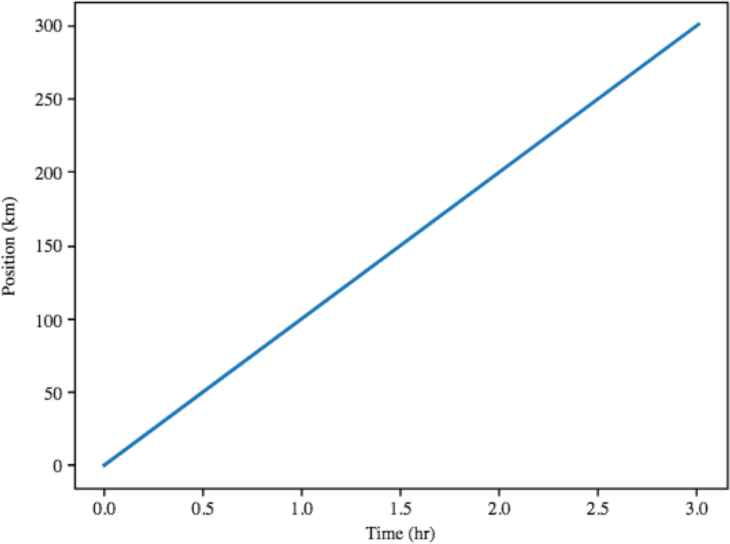
Plotting
import matplotlib.pyplot as plt
time = [0, 1, 2, 3]; position = [0, 100, 200, 300] plt.plot(time, position)
plt.xlabel('Time (hr)’) plt.ylabel('Position (km)’) plt.show()

Slide 33
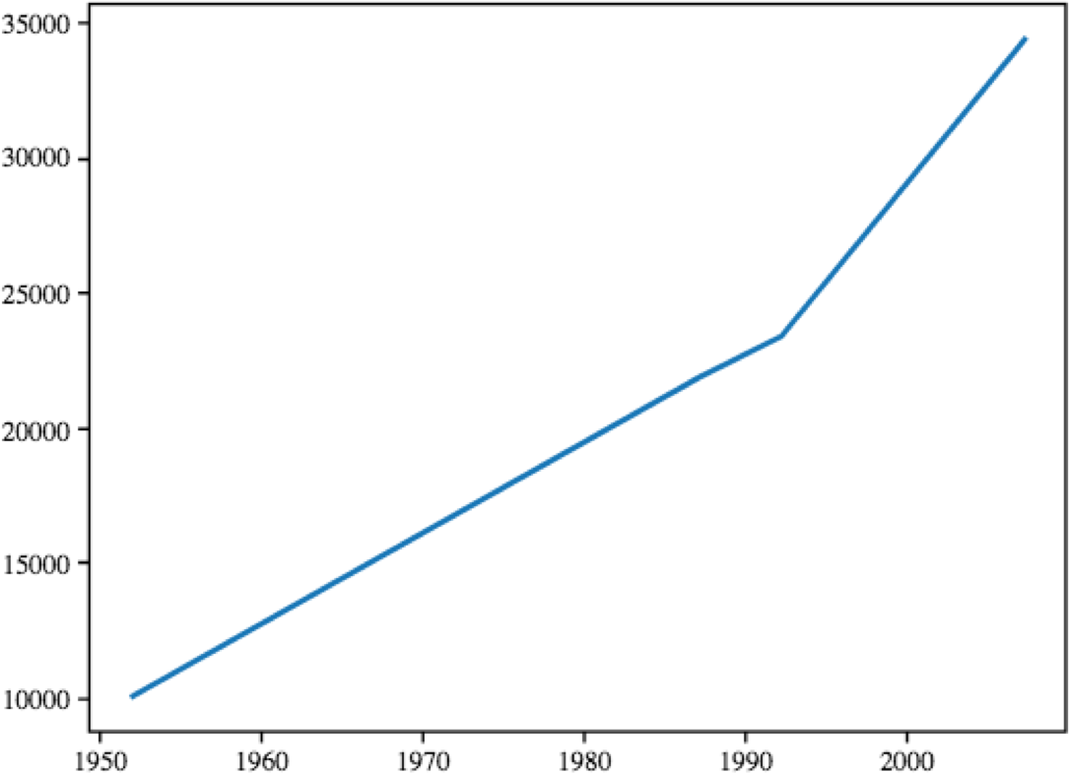
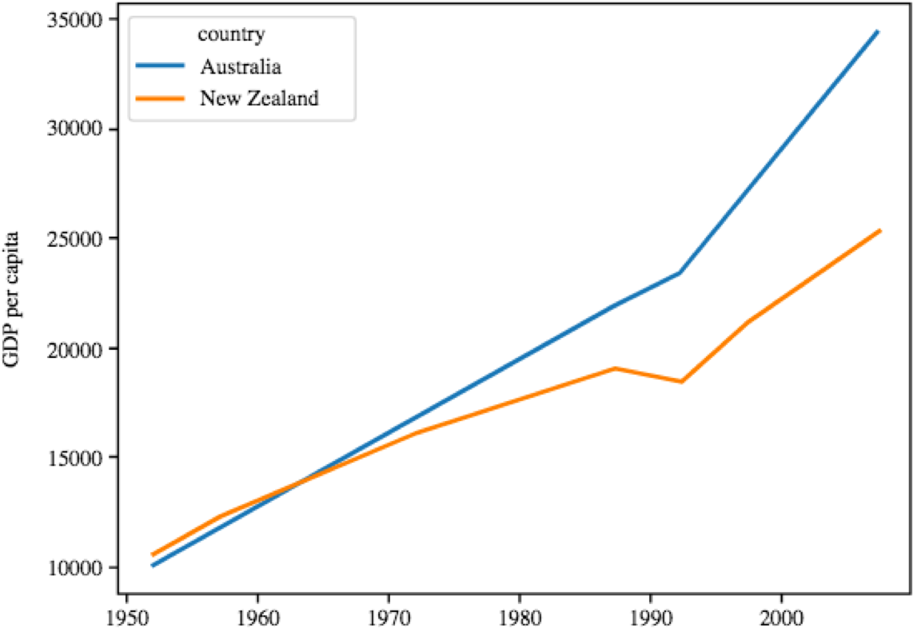
Plotting + DataFrame
import pandas as pd
data =pd.read_csv(‘gapminderdata/gapminder_gdp_oceania.csv’,
index_col='country’)
years = data.columns.str.strip('gdpPercap_')
data.columns = years.astype(int)
data.loc['Australia'].plot()
data.T.plot() plt.ylabel('GDP per capita')

Slide 34
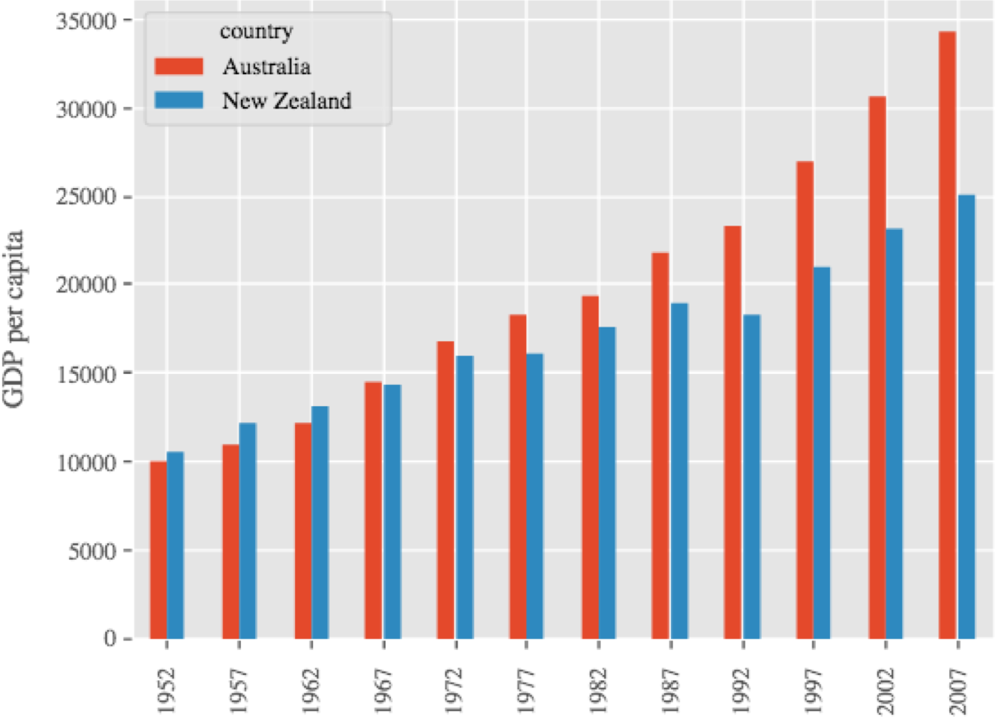
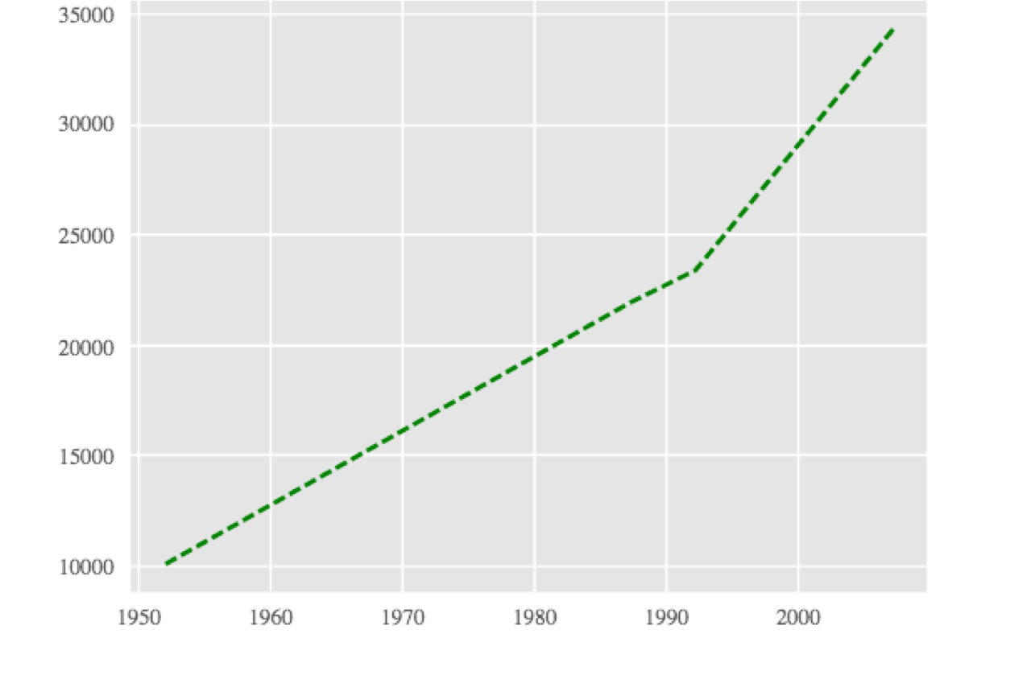
Plotting + DataFrames
plt.style.use('ggplot’) data.T.plot(kind='bar’) plt.ylabel('GDP per capita')
years = data.columns
gdp_australia = data.loc['Australia’] plt.plot(years, gdp_australia, 'g--')

Slide 35
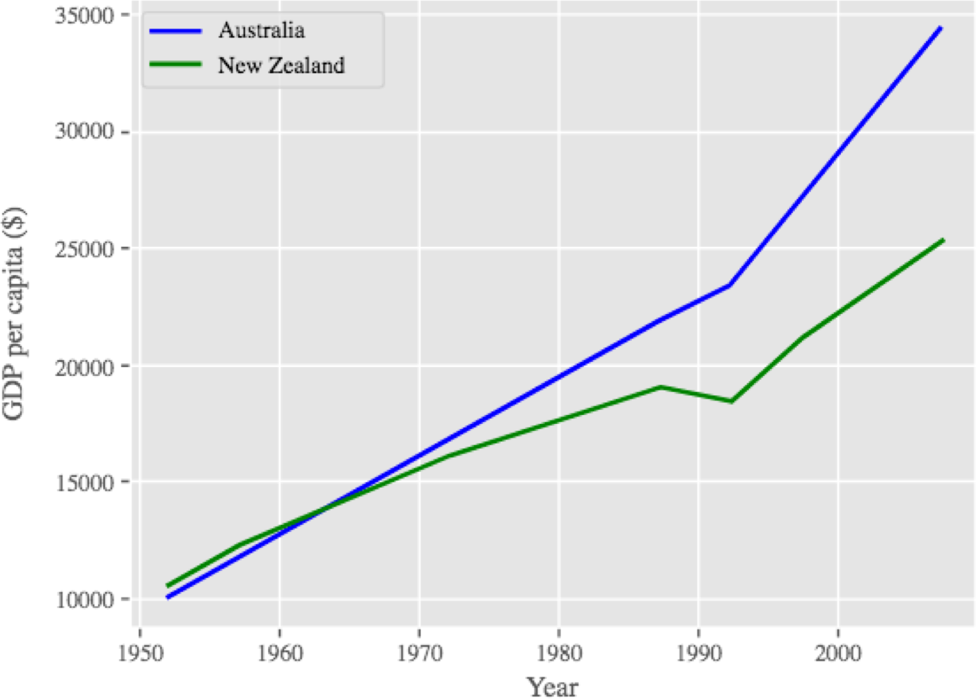
Plotting
# Select two countries' worth of data.
plt.style.use('ggplot’)
gdp_australia = data.loc['Australia’] gdp_nz = data.loc['New Zealand’]
plt.plot(years, gdp_australia, 'b-', label='Australia’) plt.plot(years, gdp_nz, 'g-', label='New Zealand’)
plt.legend(loc='upper left’) plt.xlabel('Year’) plt.ylabel('GDP per capita ($)')

Slide 36
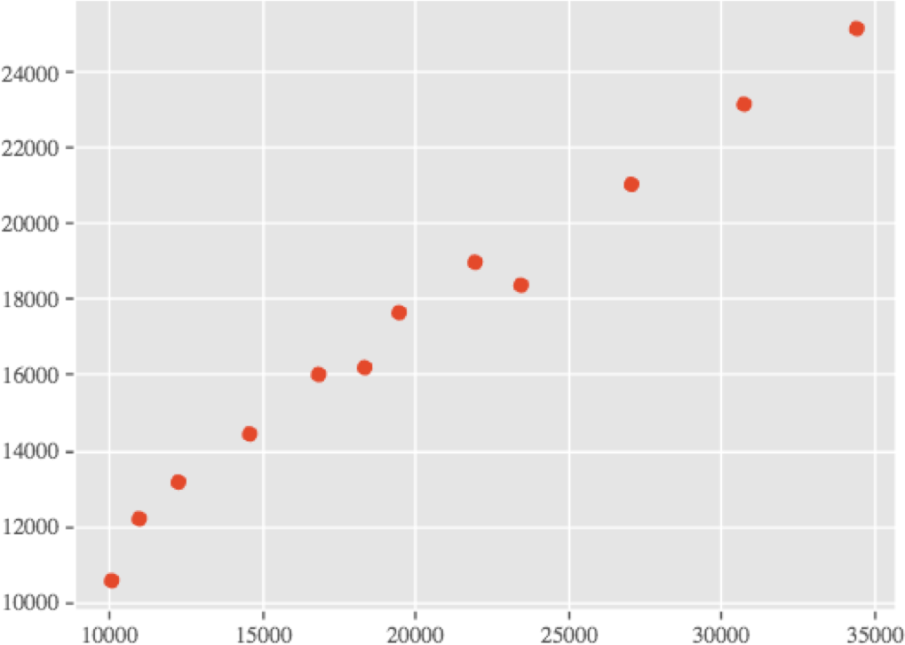
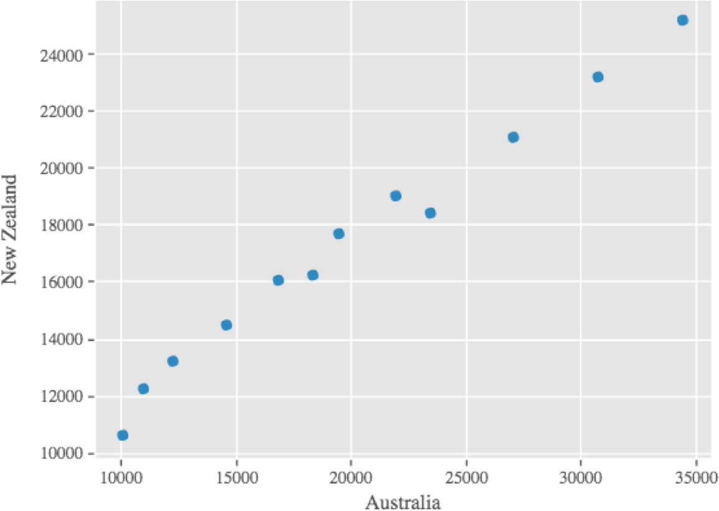
Plotting
plt.scatter(gdp_australia, gdp_nz)
data.T.plot.scatter(x = 'Australia', y = 'New Zealand')

Slide 37
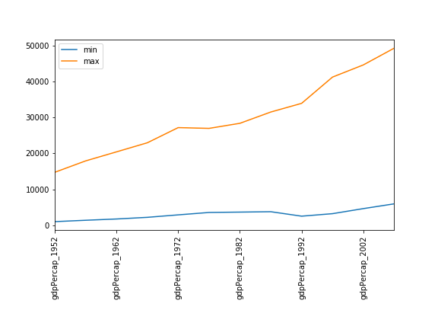
Plotting-Practice
Fill in the blanks below to plot the minimum GDP per capita over time for all the countries in Europe. Modify it again to plot the maximum GDP per capita over time for Europe.
data_europe = pd.read_csv('data/gapminder_gdp_europe.csv', index_col='country’)
data_europe. .plot(label='min’) data_europe. plt.legend(loc='best’) plt.xticks(rotation=90)

Slide 38
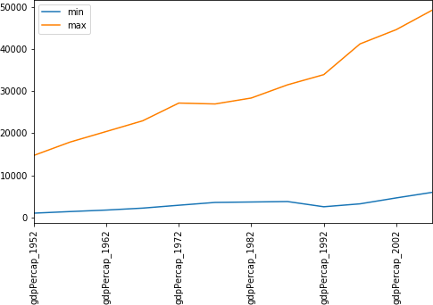
Plotting-Practice
data_europe = pd.read_csv('data/gapminder_gdp_europe.csv', index_col='country’)
data_europe.min().plot(label='min’) data_europe.max().plot(label='max’) plt.legend(loc='best’) plt.xticks(rotation=90)

Slide 39
Plotting-Saving
plt.savefig('my_figure.png’)
plt refer to a global figure variable and after a figure has been displayed to the screen
*Make sure you call plt.savefig before the plot is displayed to the* screen,
fig = plt.gcf() # get current figure
data.plot(kind='bar’)
fig.savefig('my_figure.png')

Slide 40
Keypoints
matplotlib is the most widely used scientific plotting library in Python.
Plot data directly from a Pandas dataframe.
Select and transform data, then plot it.
Many styles of plot are available: see the Python Graph Gallery for more options.
Can plot many sets of data together.

Slide 41
That’s it, that was the basics of python packages for scientists!

